Slide 1
Household
Survey Project Report
Presented
By
Aminu Abdulrasheed

Slide 2
Aim
The purpose of this project was to design and deploy a short household survey using KoboToolbox to collect and analyze basic demographic and economic data. The goal was to generate actionable insights for decision-making in community and development planning
after

Slide 3
Process
Designed a 6-question survey in KoboToolbox covering household demographics, income, and amenities.
Deployed the form online, allowing submissions without login (web and mobile collection).
Collected 14 responses across communities such as Lokoja, Ibadan, Abuja, and others.
Exported the data to Excel for cleaning and analysis.
Generated insights on household size, income levels, and access to amenities

Slide 4
Insight
Average household size: 7.6 (median: 6), indicating relatively large family structures.
Main income source: 64% salary, 29% business, 7% others.
Monthly household income range: 36% between ₦50k–₦100k, 36% between ₦50k–₦200k, above ₦200k, 21% and 7% below ₦50k.
Amenities: 93% have electricity, Sanitation 50% but only 36% report access to clean water and internet.
Community spread: Responses covered Lokoja (21%), Ibadan (21%), Okene,Lagos and other towns.

Slide 5
Recommendations
Expand clean water initiatives in underserved communities.
Government supports small business development, as nearly 29% of households rely on business income.
Financial assistance from the state/ Federal for low-income households earning below ₦50k.
Invest in internet connectivity to improve digital inclusion, especially in rural areas.
Also, there should be provision for good hygiene water supply in both Rural and Cities

Slide 6
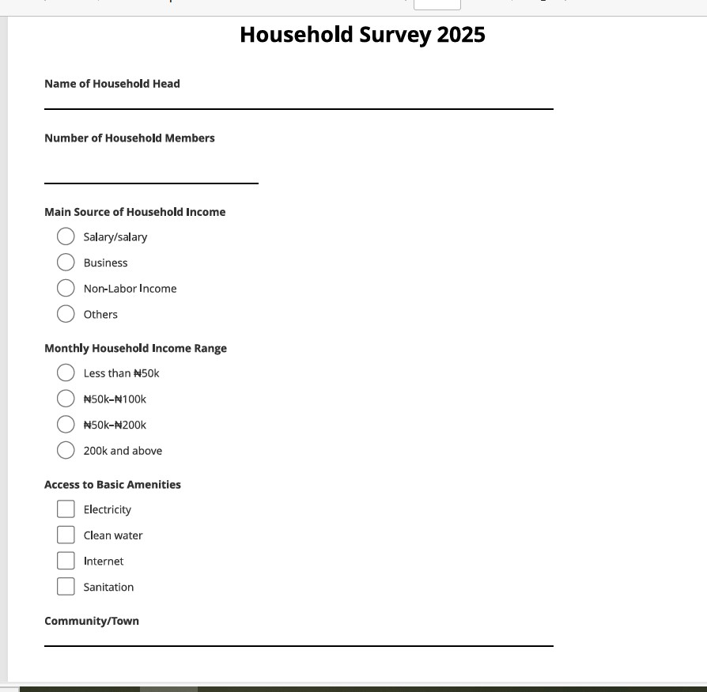
Form Design

Slide 7
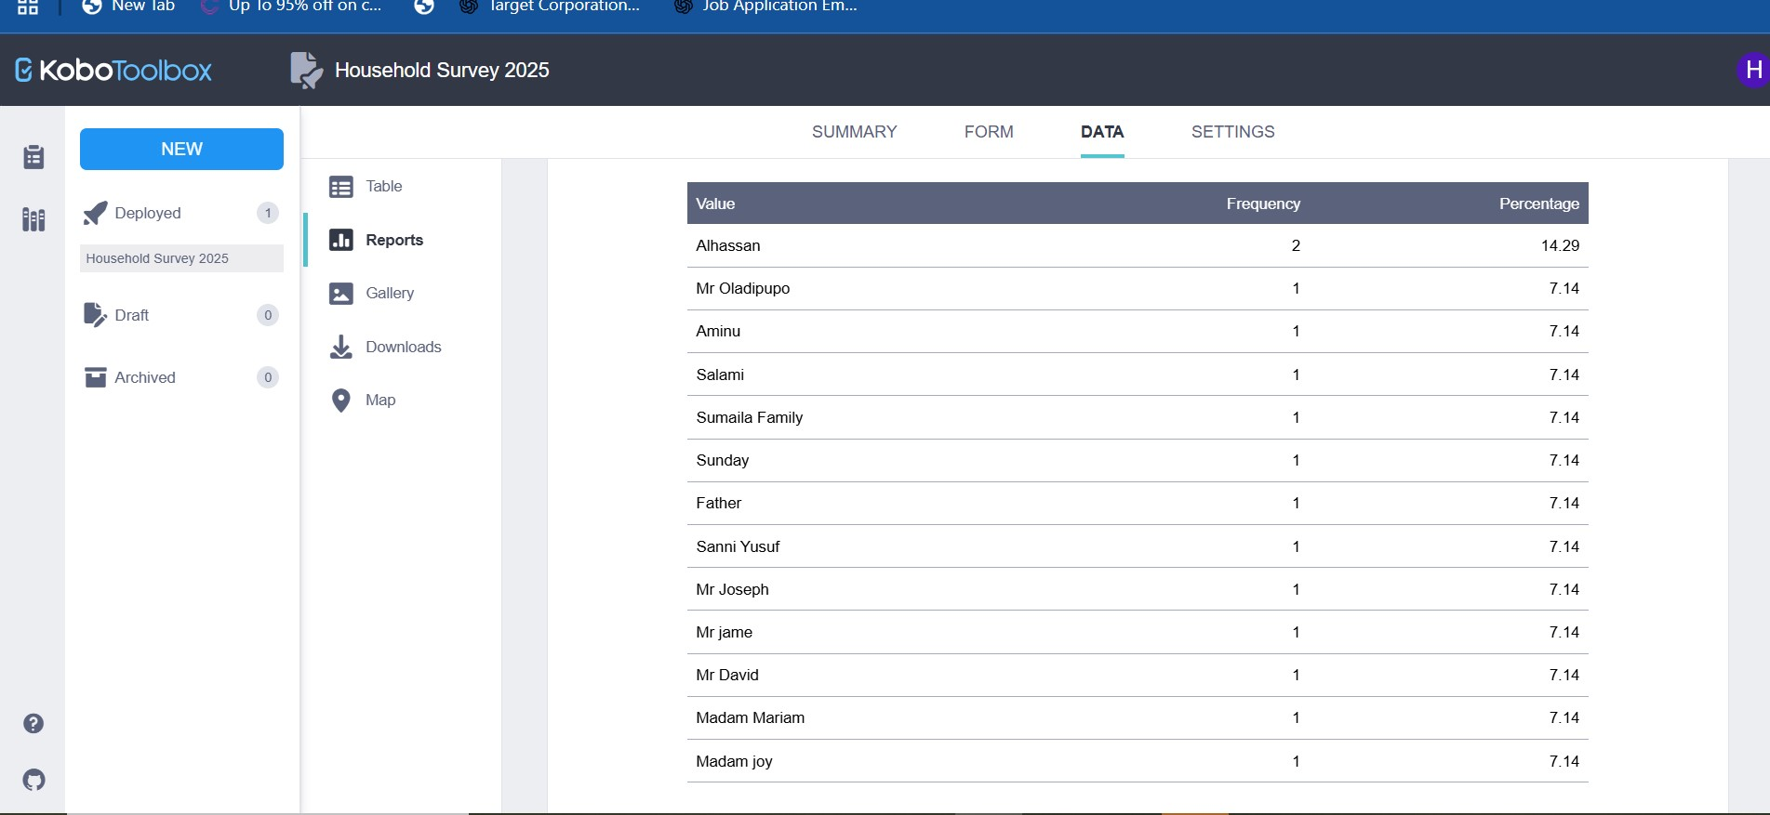
Report

Slide 8
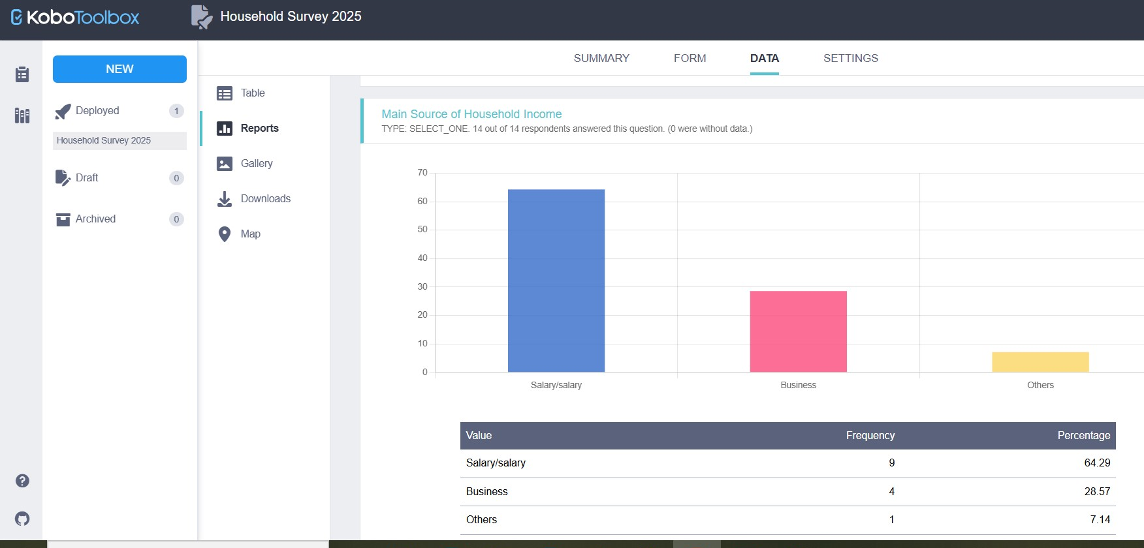
Report

Slide 9
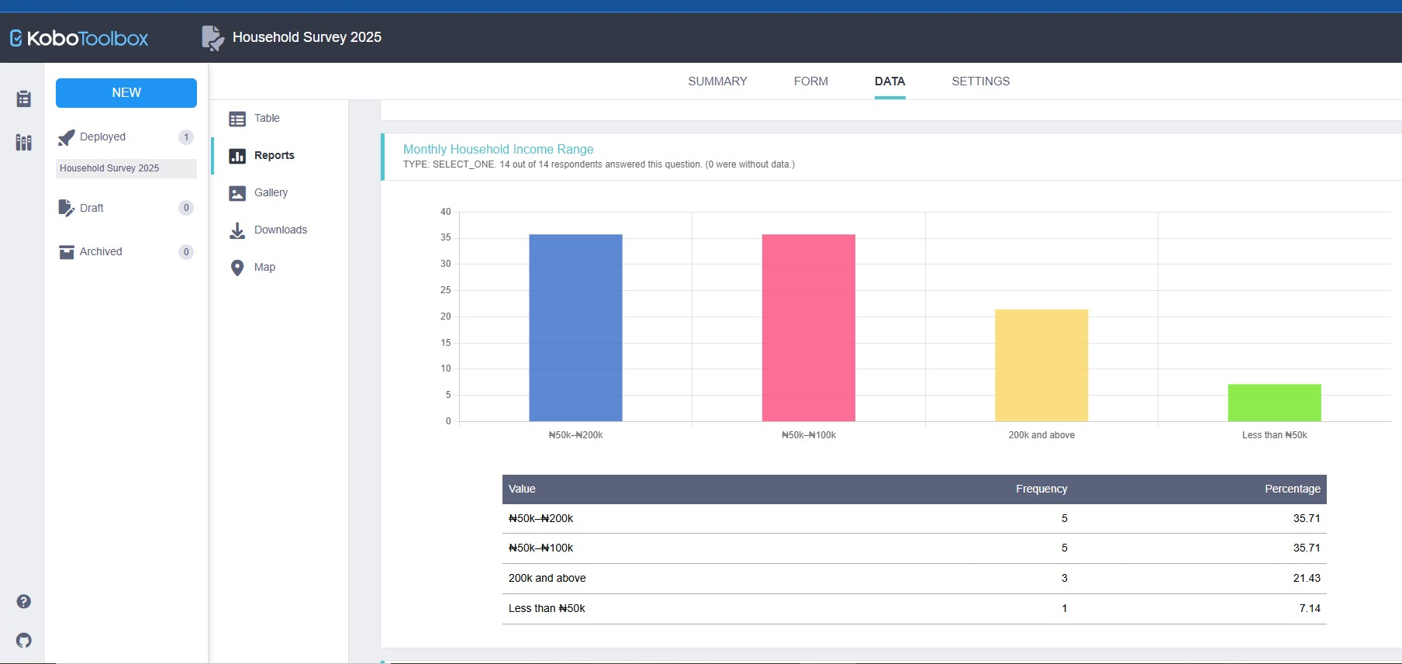
Report

Slide 10
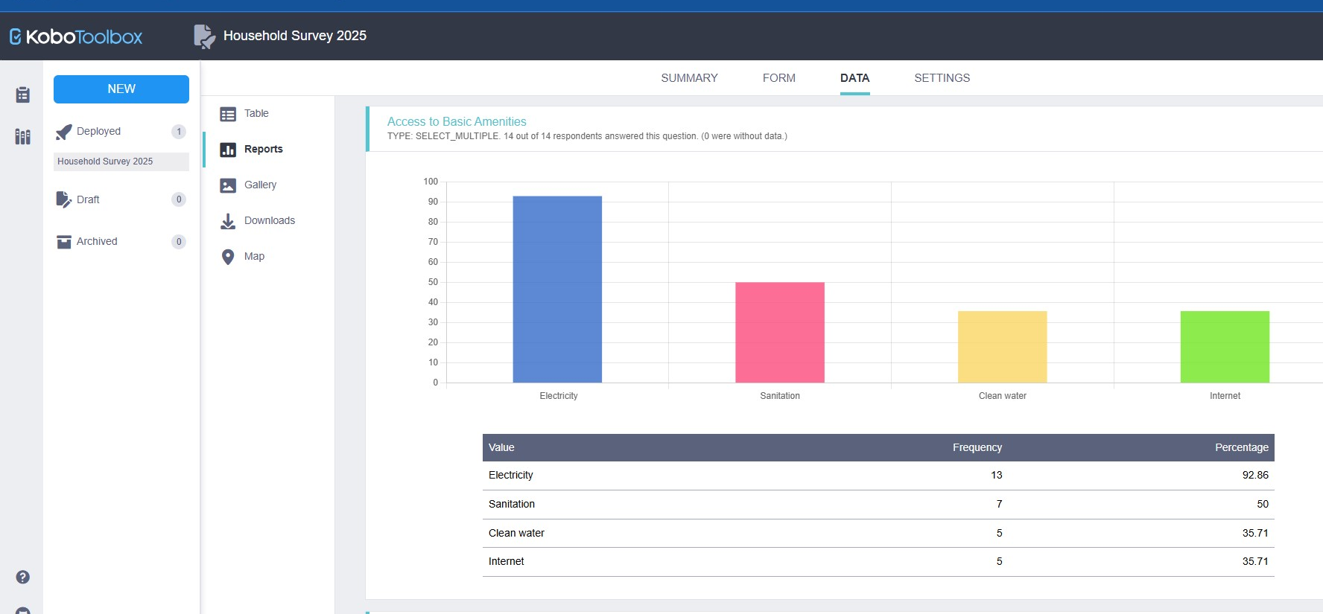
Report

Slide 11
THANK YOU

